Slide 1
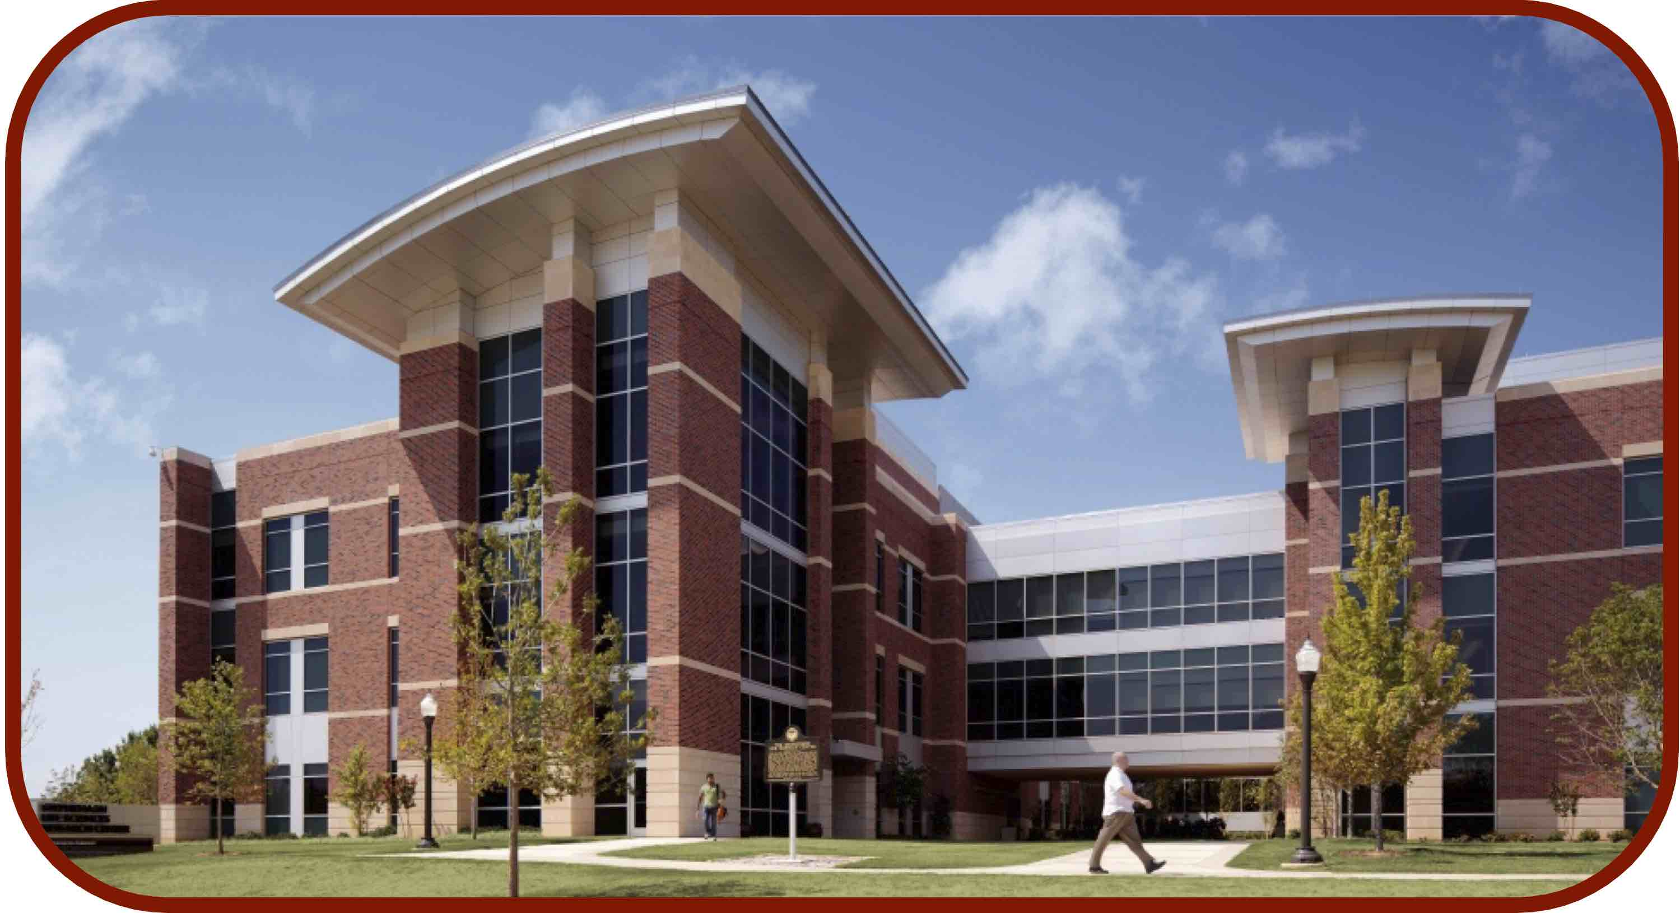
Molecular Dynamics Simulations
CCATS Group

Slide 2
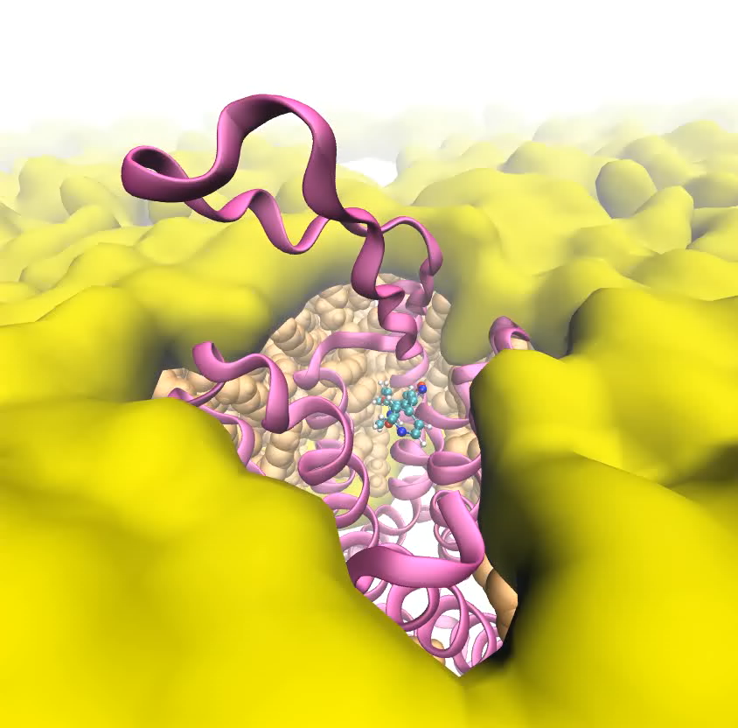
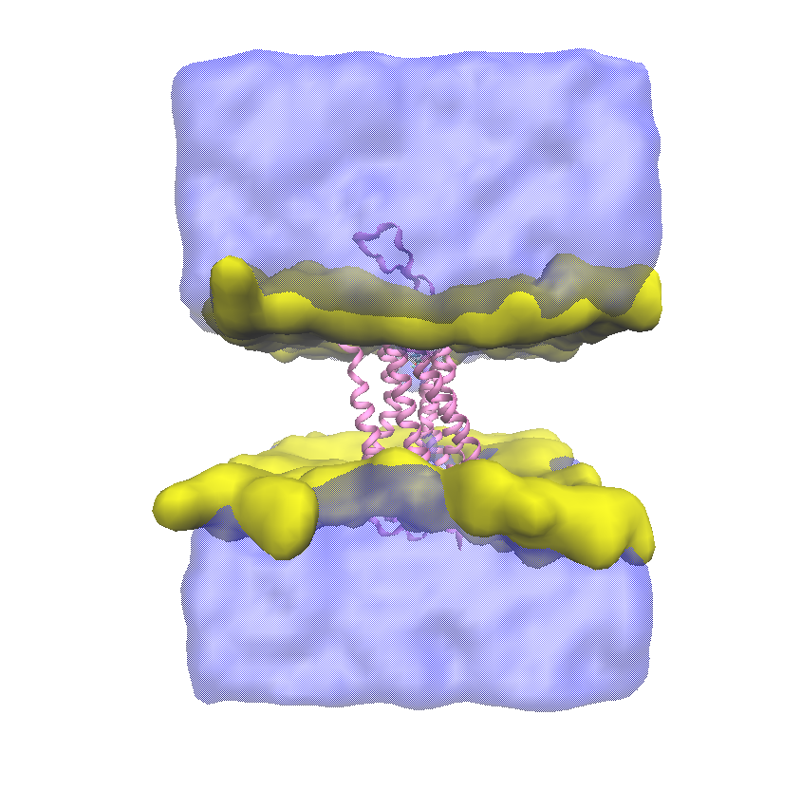
What Do We Do in Molecular Dynamics Simulations?
Use Newtonian mechanics to capture the real-time motion of chemical or biological systems
Truncated mGluR7 (PDB 7EPC)
MMPIP (ligand; AutoDock Vina)
POPC (lipid membrane)
Water
100 ns Trajectory
*Lipid tail group not shown

Slide 3
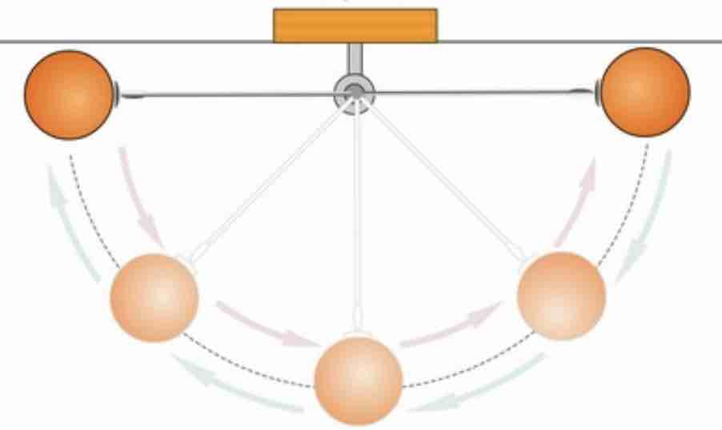
What Do We Do in Molecular Dynamics Simulations?
Use Newtonian mechanics to capture the real-time motion of chemical or biological systems
Coordinates: $x=\left[x_{1},y_{1},z_{1},x_{2},y_{2},z_{2},⋯,x_{N},y_{N},z_{N}\right]$
Velocities: $v=\left[v_{x1},v_{y1},v_{z1},v_{x2},v_{y2},v_{z2},⋯,v_{xN},v_{yN},v_{zN}\right]$
Classical trajectory: $x(t_{0}),v(t_{0})⟶x(t_{0}+Δt),v(t_{0}+Δt)$
coordinate propagation: $x(t_{0}+Δt)=x(t_{0})+v(t_{0})Δt$
velocity propagatory: $v(t_{0}+Δt)=v(t_{0})-{\frac{1}{m}\frac{∂U(x)}{∂x}|}_{x=x(t_{0})}Δt$
t+3*𝛥t
v
t+2*𝛥t
t+𝛥t
t
x

Slide 4
What Do We Need to Peform a MD Simulation?
A good computer (like schooner)
MD simulation software
AMBER (Peter Kollman, David Case, Carols Simmingling, Adrian Roitberg, Ken Merz, Junmei Wang, Tom Cheatham)
CHARMM (Martin Karplus, Charles Brooks, Bernard Brooks, Alex McKerell, Benoit Roux, ….)
GROMACS (Erik Lindahl, Berend Smit)
NAMD (Klaus Schulten)
OpenMM (John Chodera, Tom Markland, Bernard Brooks)
An initial structure (and atomic velocity): $x(t_{0}),v(t_{0})$
Adding missed residues, hydrogen atoms, solvent molecules, counter ions
A trajectory propagation scheme: $x(t_{0}),v(t_{0})⟶x(t_{0}+Δt),v(t_{0}+Δt)$
Velocity Verlet, leapfrog

Slide 5
Different Types of Basic MD Simulations
NVE (microcanonial ensemble)
Constant number of particles, constant volume, and constant energy
The system does not have an uniform temperature
NPT (canonical ensemble)
Constant number of particles, constant pressure, and constant temperature
NVT (canonical ensemble)
Constant number of particles, constant volume, and constant temperature

Slide 6
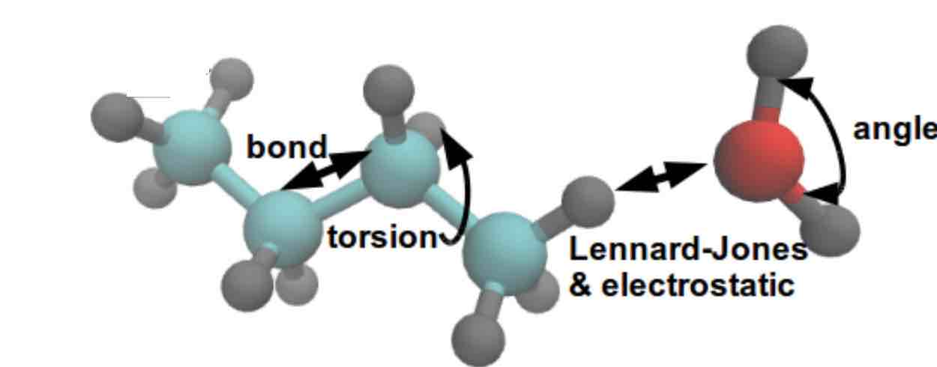
Potential Energy: Classical Force Fields
bonded
terms
$$U=U_{\text{bond}}+U_{\text{angle}}+U_{\text{torsion}}$$
$$+U_{\text{van-der-Waals}}+U_{\text{electrostatic}}$$
non-bonded
terms
$$U_{\text{vdW}}=\overset{atoms}{\underset{i<j}{∑}}\left[{\left(\frac{σ}{r_{ij}}\right)}^{12}-2{\left(\frac{σ}{r_{ij}}\right)}^{6}\right]$$
$$U_{\text{bond}}=\underset{b∈\text{bonds}}{∑}k_{b}{\left(r_{b}-r_{b}^{\text{eq}}\right)}^{2}$$
$$U_{\text{angle}}=\underset{a∈\text{angles}}{∑}k_{a}{\left(θ_{a}-θ_{a}^{\text{eq}}\right)}^{2}$$
$$U_{\text{electrostatic}}=\overset{atoms}{\underset{i<j}{∑}}\frac{q_{i}q_{j}}{4πε_{0}r_{ij}}$$
$$U_{\text{torsion}}=\underset{t∈\text{torsions}}{∑}\overset{3}{\underset{n=1}{∑}}k_{t}\left[1+\text{cos}\left(nϕ_{t}-γ_{n}\right)\right]$$

Slide 7
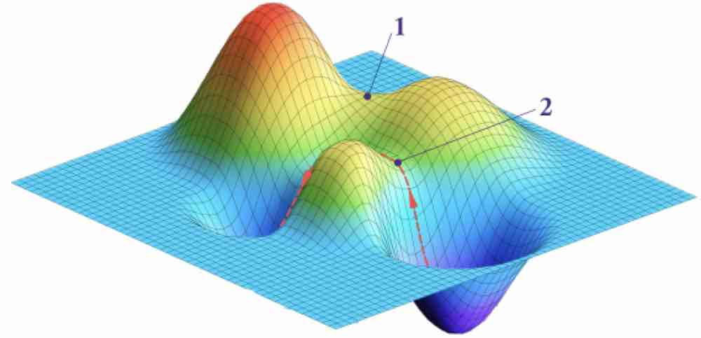
Potential Energy Surfaces
Classical mechanical mechanics (MM) force fields
Macromolecular conformational changes; ligand-receptor binding
Ground-state QM/MM energy functions: enzyme reactions
Excited-state QM/MM energy functions: photochemistry and photobiology

Slide 8

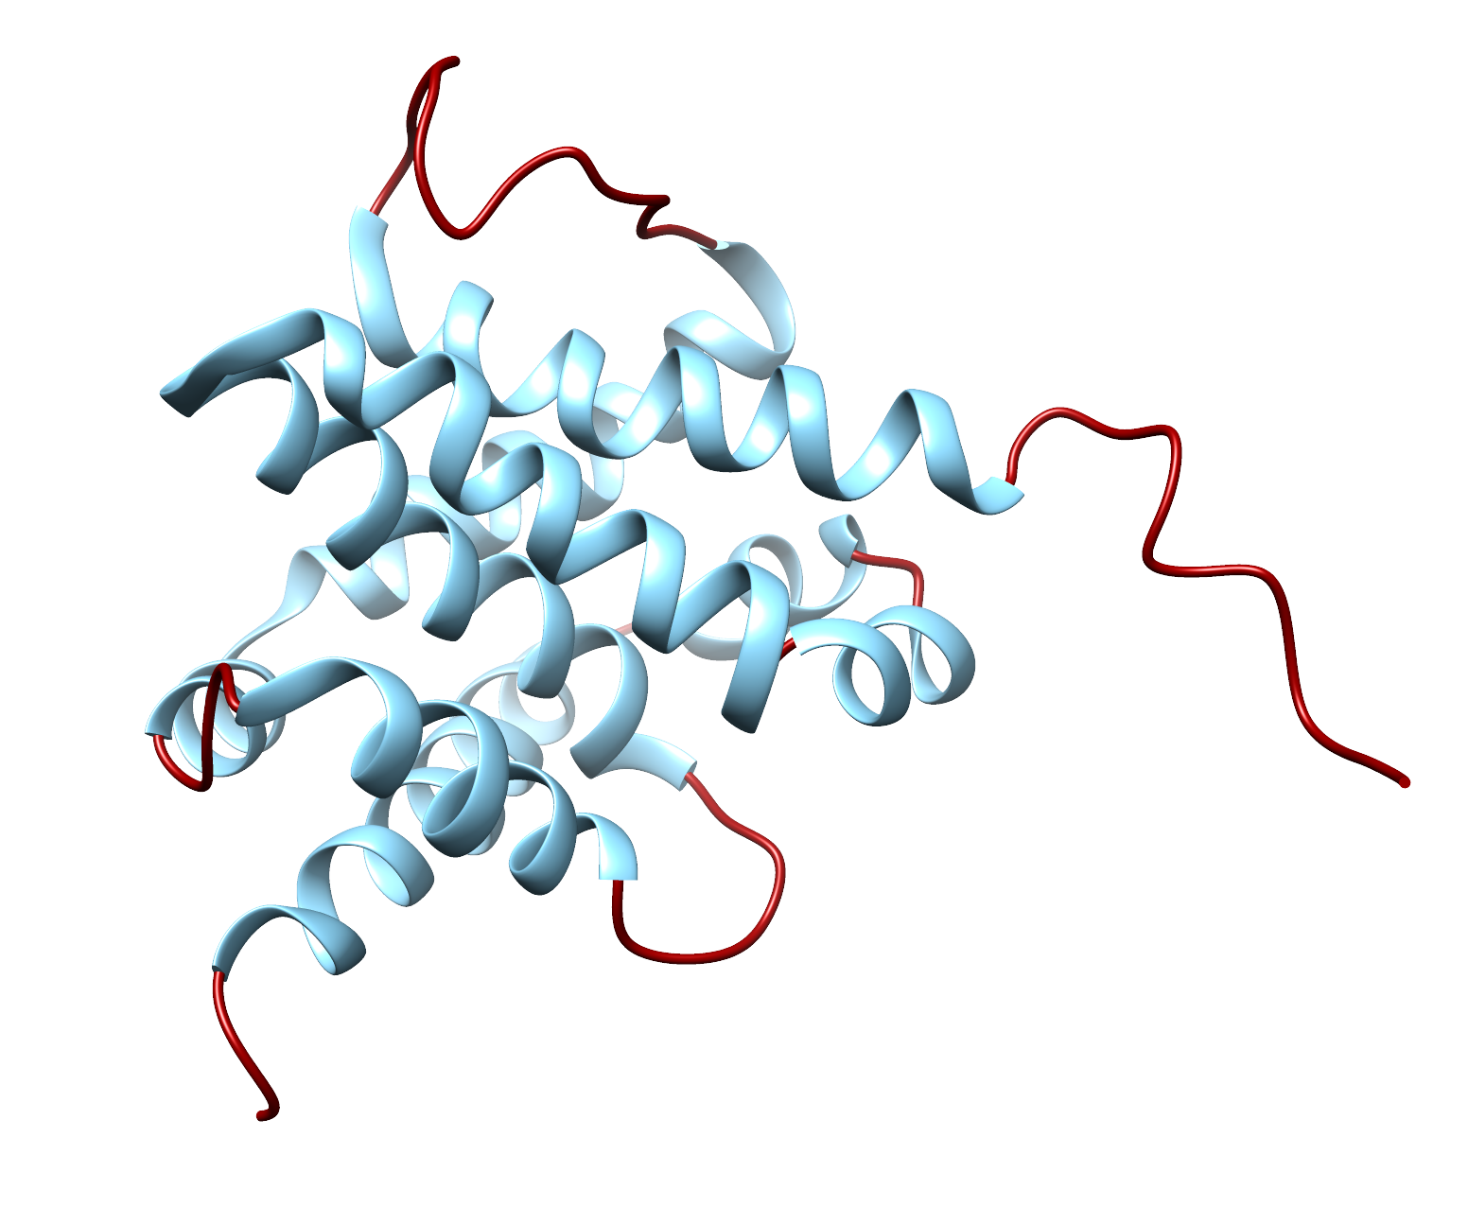

General Workflow
Parameter /Topology File
atom/bond/angles information
Coordinate File
Atom coordinates
Box information
Sometimes velocities
Equilibration (0.5 - 20 ns)
Minimization
Solvent then solute
Heating (NVT)
Heat to temp (300K)
Pressure (NPT)
Density to 1 bar
Production (100 ns <)
NVT or NPT
Initial coordinates
RCSB
Molecular Docking
Alpha-RoseTTA-Omega-Fold

Slide 9
OpenMM with AMBER Force Field
We will follow the Colab notebook prepared by Arantes and co-workers:
https://github.com/pablo-arantes/making-it-rain
Copy the modified version to your Google Drive:
https://colab.research.google.com/drive/1ZNvKJV2zIZg85H5Ja6QILhLUW9ozCxdM?usp=sharing
Changes I made are:
Example is Bax (PDB 1F16)
Input/Output names are kept consistent
Units are kept consistent

Slide 10
MM-GBSA / MM-PBSA
&
Trajectory Analysis
CCATS Group

Slide 11
MM-GBSA / MM-PBSA
Molecular Mechanics - Generalized Born Surface Area (MM-GBSA)
Molecular Mechanics - Poisson-Boltzmann Surface Area (MM-PBSA)
Predict the binding free energy of complexes or transitions between conformations (State A $→$B)
More accurate than scoring functions (Molecular Docking)
Not computationally expensive as other methods (Alchemical, etc.)
MM | Type of energy function used to compute potential energy of molecular structure (force fields).
GBSA/PBSA | Calculates the electrostatic potentials of a solute in solution.

Slide 12

MM-GBSA / MM-PBSA
$$[Ligand]_{aq}+[Protein]_{aq}↔[Complex]_{aq}$$
Ligand Binding Example
Goal is to calculate the free energy difference between two states (bound and unbound) of solvated molecules
PB/GB = Implicit Solvent Model
GB: Generalized Born
PB: Poisson-Boltzmann
$$\text{(1)}$$
$$ΔG_{bind}=⟨G_{Complex}⟩-[⟨G_{Protein}⟩+⟨G_{Ligand}⟩]$$
$$\text{(1a)}$$
$$ΔG_{bind}=E_{bonded}+E_{nonbonded}+G_{polar}+G_{nonpolar}-TS$$
MM
GB/PB
SASA
$$ΔG_{solvation}$$
http://ambermd.org/tutorials/advanced/tutorial3/

Slide 13
MM-GBSA
Generalized Born (1/4)
$$[Ligand]_{aq}+[Protein]_{aq}↔[Complex]_{aq}$$
$$ΔG_{polar}≈-\frac{1}{2}\underset{ij}{∑}\frac{q_{i}q_{j}}{f_{GB}(r_{ij}R_{i}R_{j})}\left(1-\frac{exp[-κf_{GB}]}{ϵ}\right)$$
$$\text{(1)}$$
$$ΔG_{bind}=⟨G_{Complex}⟩-[⟨G_{Protein}⟩+⟨G_{Ligand}⟩]$$
$$\text{(1a)}$$
$$ΔG_{bind}=E_{bonded}+E_{nonbonded}+G_{polar}+G_{nonpolar}-TS$$
MM
GB/PB
SASA
$$ΔG_{solvation}$$
http://ambermd.org/tutorials/advanced/tutorial3/

Slide 14
MM-PBSA
Generalized Born (1/4)
Poisson-Boltzmann (ALPB, 1/4)
$$[Ligand]_{aq}+[Protein]_{aq}↔[Complex]_{aq}$$
$$ΔG_{polar}≈-\frac{1}{2}\underset{ij}{∑}\frac{q_{i}q_{j}}{f_{GB}(r_{ij}R_{i}R_{j})}\left(1-\frac{exp[-κf_{GB}]}{ϵ}\right)$$
$$ΔG_{polar}≈-\frac{1}{2}\left(\frac{1}{ϵ_{in}}-\frac{1}{ϵ_{ex}}\right)\frac{1}{1+αβ}\underset{ij}{∑}q_{i}q_{j}\left(\frac{1}{f_{GB}}+\frac{αβ}{A}\right)$$
$$\text{(1)}$$
$$ΔG_{bind}=⟨G_{Complex}⟩-[⟨G_{Protein}⟩+⟨G_{Ligand}⟩]$$
$$\text{(1a)}$$
$$ΔG_{bind}=E_{bonded}+E_{nonbonded}+G_{polar}+G_{nonpolar}-TS$$
MM
GB/PB
SASA
$$ΔG_{solvation}$$
http://ambermd.org/tutorials/advanced/tutorial3/

Slide 15
SASA
Generalized Born (1/4)
Poisson-Boltzmann (ALPB, 1/4)
Solvent Accessible Surface Area (SASA)
Linear Combination of Pairwise Overlaps (LCPO)
$$[Ligand]_{aq}+[Protein]_{aq}↔[Complex]_{aq}$$
$$ΔG_{polar}≈-\frac{1}{2}\underset{ij}{∑}\frac{q_{i}q_{j}}{f_{GB}(r_{ij}R_{i}R_{j})}\left(1-\frac{exp[-κf_{GB}]}{ϵ}\right)$$
$$ΔG_{polar}≈-\frac{1}{2}\left(\frac{1}{ϵ_{in}}-\frac{1}{ϵ_{ex}}\right)\frac{1}{1+αβ}\underset{ij}{∑}q_{i}q_{j}\left(\frac{1}{f_{GB}}+\frac{αβ}{A}\right)$$
$$ΔG_{nonpolar}=γSASA$$
$$\text{(1)}$$
$$ΔG_{bind}=⟨G_{Complex}⟩-[⟨G_{Protein}⟩+⟨G_{Ligand}⟩]$$
$$S_{i}=4πr^{2}$$
$$\text{(1a)}$$
$$ΔG_{bind}=E_{bonded}+E_{nonbonded}+G_{polar}+G_{nonpolar}-TS$$
$$A_{ij}=2πr_{i}\left(r_{i}-\frac{r_{ij}}{2}-\frac{r_{i}^{2}-r_{j}^{2}}{2r_{ij}}\right)$$
$$SASA_{i}=β_{1}S_{i}+β_{2}\underset{j∈N(i)}{∑}A_{ij}+β_{3}\underset{\begin{aligned}j,k∈N(i) \\ k∈N(j) \\ k≠j\end{aligned}}{∑}A_{jk}+β_{4}\underset{j∈N(i)}{∑}\left(A_{ij}\underset{\begin{aligned}k∈N(i) \\ k∈N(j) \\ k≠j\end{aligned}}{∑}A_{jk}\right)$$
MM
GB/PB
SASA
$$ΔG_{solvation}$$
http://ambermd.org/tutorials/advanced/tutorial3/

Slide 16
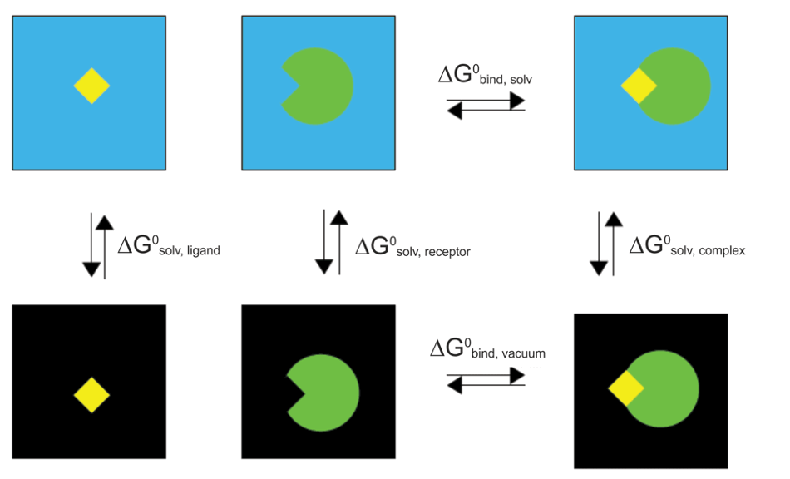
SASA
Thermodynamic Cycle
$$[Ligand]_{aq}+[Protein]_{aq}↔[Complex]_{aq}$$
$$ΔG_{binding,complex}^{0}=ΔG_{bind,vacuum}^{0}+ΔG_{solv,complex}^{0}$$
$$\text{(1)}$$
$$ΔG_{bind}=⟨G_{Complex}⟩-[⟨G_{Protein}⟩+⟨G_{Ligand}⟩]$$
$$-(ΔG_{solv,ligand}^{0}+ΔG_{solv,protein}^{0})$$
$$\text{(2)}$$
$$\text{(1a)}$$
$$ΔG_{bind}=E_{bonded}+E_{nonbonded}+G_{polar}+G_{nonpolar}-TS$$
$$ΔG_{solv}^{0}=ΔG_{polar,ϵ=80}-ΔG_{polar,ϵ=1}+ΔG_{nonpolar}$$
$$\text{(2a)}$$
MM
GB/PB
SASA
$$ΔG_{solvation}$$
$$ΔG_{polar,ϵ=1}=ΔG_{vacuum}=ΔE_{MM}-TΔS_{NMA}$$
$$\text{(2b)}$$
http://ambermd.org/tutorials/advanced/tutorial3/

Slide 17
SASA
Thermodynamic Cycle
$$[Ligand]_{aq}+[Protein]_{aq}↔[Complex]_{aq}$$
$$ΔG_{solv,complex}^{0}=ΔG_{bind,vacuum}^{0}+ΔG_{solv,complex}^{0}$$
$$\text{(1)}$$
$$ΔG_{bind}=⟨G_{Complex}⟩-[⟨G_{Protein}⟩+⟨G_{Ligand}⟩]$$
$$-(ΔG_{solv,ligand}^{0}+ΔG_{solv,protein}^{0})$$
$$\text{(2)}$$
$$\text{(1a)}$$
$$ΔG_{bind}=E_{bonded}+E_{nonbonded}+G_{polar}+G_{nonpolar}-TS$$
$$ΔG_{solv}^{0}=ΔG_{polar,ϵ=80}-ΔG_{polar,ϵ=1}+ΔG_{nonpolar}$$
$$\text{(2a)}$$
MM
GB/PB
SASA
$$ΔG_{solvation}$$
$$ΔG_{polar,ϵ=1}=ΔG_{vacuum}=ΔE_{MM}-TΔS_{NMA}$$
$$\text{(2b)}$$
http://ambermd.org/tutorials/advanced/tutorial3/

Slide 18
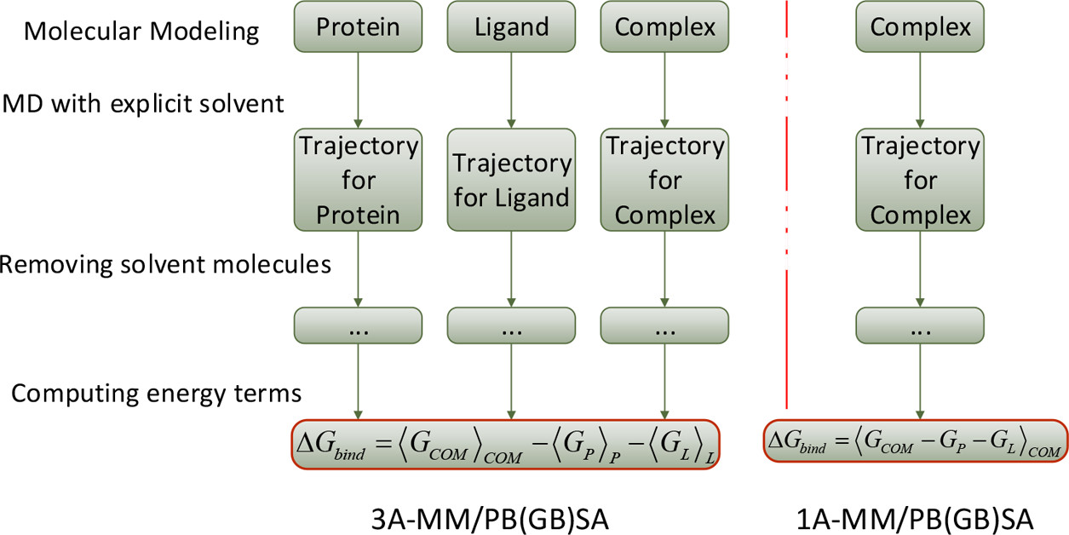
Workflow
Wang, E., et al., Chemical Reviews, 2019, 119, 16, 9478

Slide 19
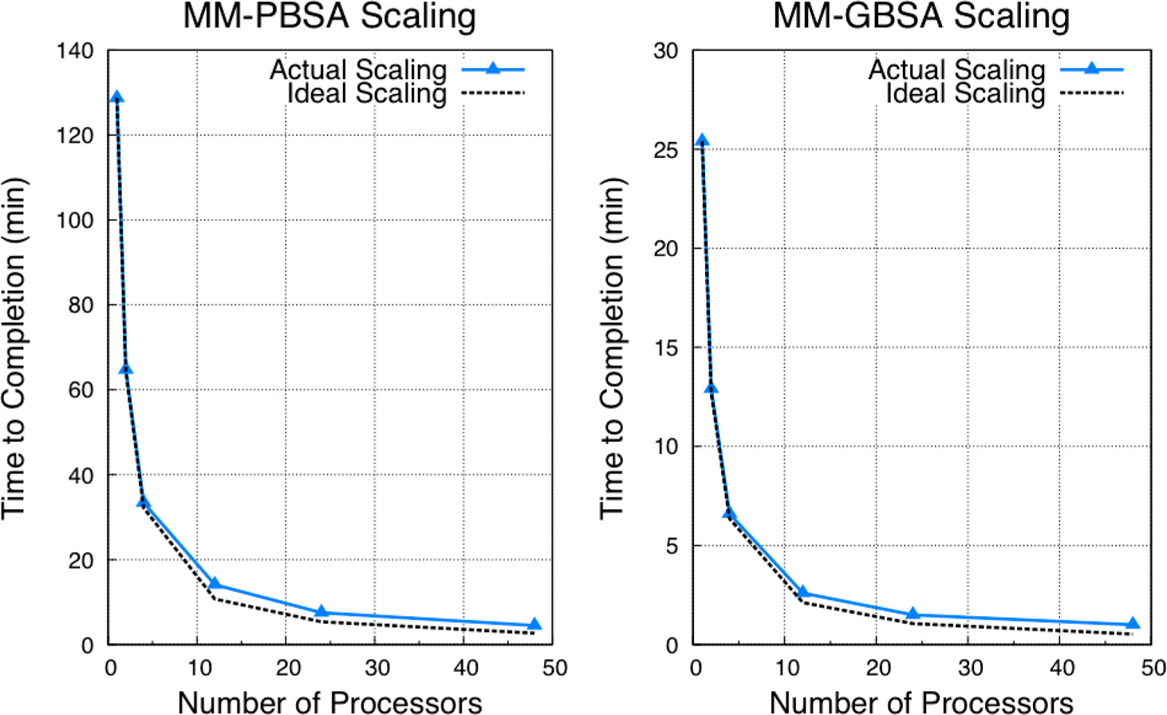
GB verus PB
MMPBSA.py scaling comparison on 200 frames of a 5910-atom complex. All calculations were performed on NICS Keeneland (2 Intel Westmere 6-core CPUs per node, QDR infiniband interconnect).
Miller, B. R., et al., JCTC, 2012, 8, 9, 3314

Slide 20
Caveats
Method (CG or PB) accuracy depends on system
Error often > ~2 kcal/mol
Single trajectory assumes no significant conformational changes
Can lead to overstabilization of binding
Multiple trajectories often have much higher standard error
Entropy of water is ignored at binding site
Normal Mode Analysis can compute entropy
Significantly increases computational cost

Slide 21
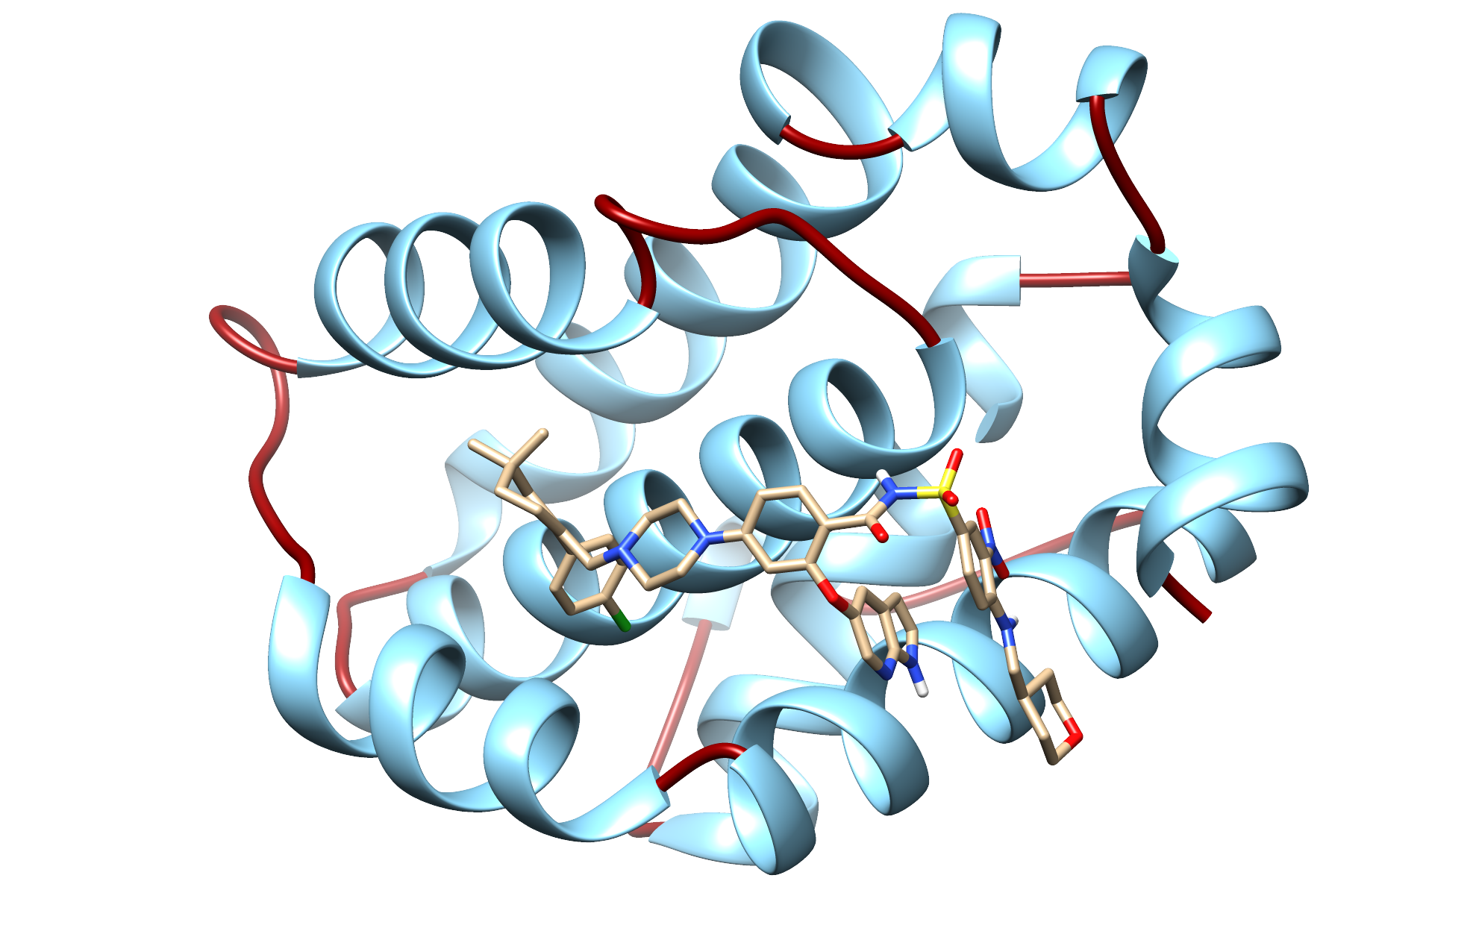
Bcl-2 & Venetoclax

